Slide 1
Group
Presentation
Created by
Potyondi Zsombor
Komjáti Gábor
Lengyel Dániel

Slide 2

Content
Assignment of tasks
Project manager tools
Potyondi Zsombor
Komjáti Gábor
Lengyel Dániel

Slide 3

Assignment of tasks
Potyondi Zsombor – Document scanning
Komjáti Gábor – camera drawing
Lengyel Dániel – Number plate recognition

Slide 4
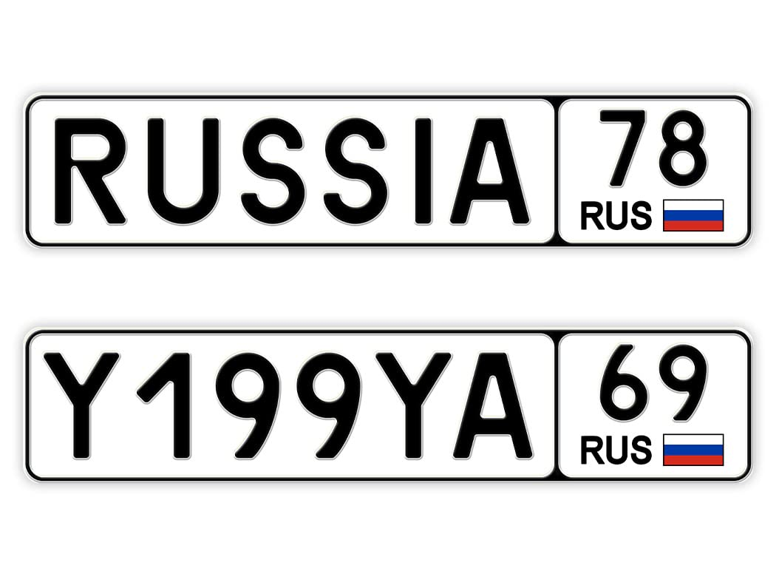
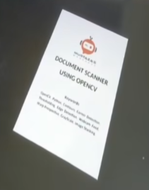


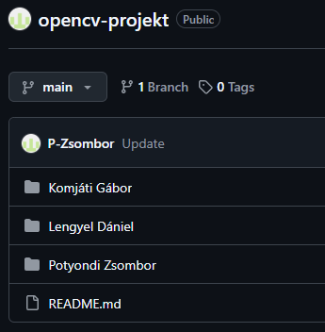
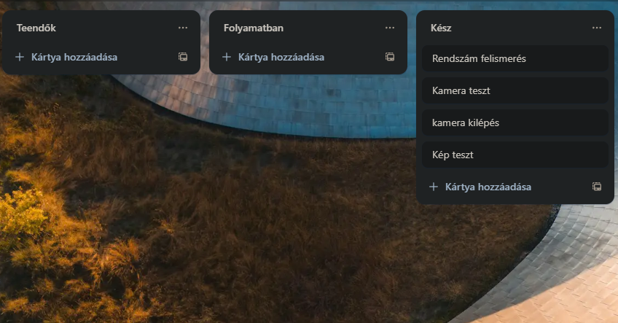

Project manager tools
Project Manager tool: trello
Programming tool: Pycharm
Programming language: python
Source Tools used: camera, images
Project Uploaded from: Github

Slide 5
Potyondi Zsombor – Document scanning

Slide 6
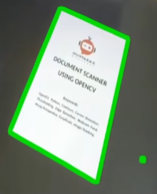
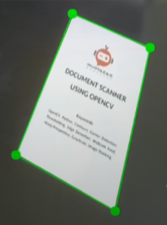
Structure of the code I. Potyondi Zsombor – Document scanning
Image Scanning:
Import library
Setting up the camera
Save camera image
2. Image processing:
Grayscale the image
Blur image
Highlight edges
3. Search for contours:
Find all contours
Selecting the square contours
Select the largest contour

Slide 7
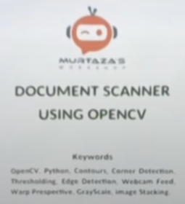
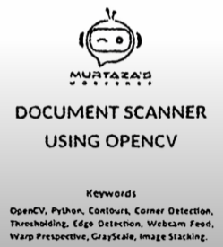
Structure of the code II. Potyondi Zsombor – Document scanning
4. Perspective correction:
Project the contour onto a rectangle
Cropping and resizing the image
5. Merge images:
Combining images
Displaying different images
6. Continuous processing of images:
Continuous reading of camera images
Processing all images
The program runs until the 'q' key is pressed

Slide 8
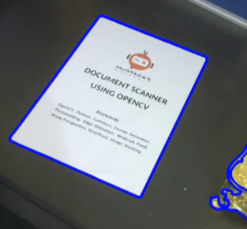
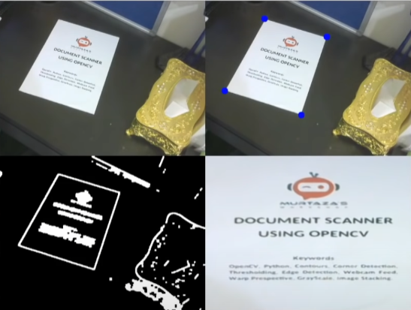
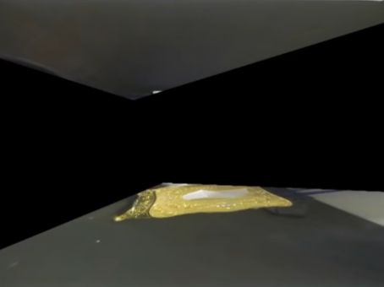
Testing the code Potyondi Zsombor – Document scanning

Slide 9
Komjáti Gábor – camera drawing

Slide 10
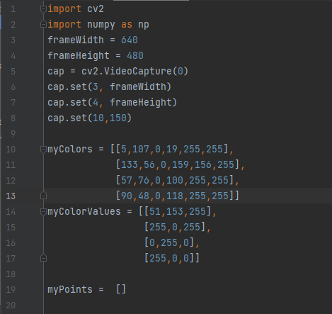
Structure of the code I. Komjáti Gábor – camera drawing
This code is based on a color object tracker with OpenCV.
It sets the image size and brightness of the webcam.
Defines a myColors list containing a range of different colors.
In the myColorValues list, it specifies the display colors assigned to the detected colors (e.g. if an orange object is found, it can be marked with a blue dot).
Creates a myPoints list, which stores the coordinates of the tracked points.

Slide 11
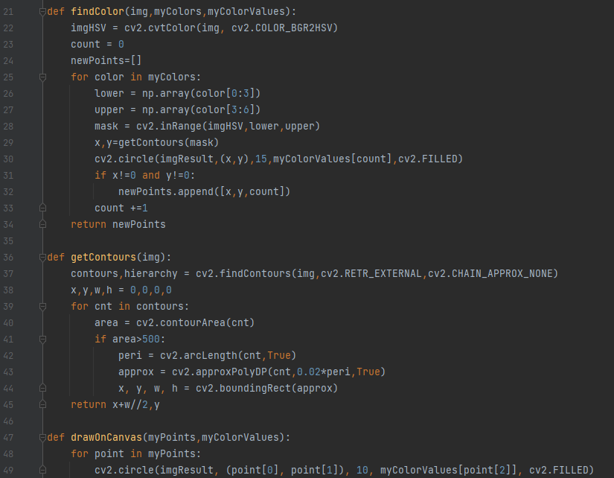
Structure of the code II. Komjáti Gábor – camera drawing
1. findColor(img, myColors, myColorValues)Finds the preset colors in the image.
If it finds a color spot, it determines its center (getContours).
It stores the found points and marks them with a circle in the image.
2. getContours(img) and drawOnCanvas(myPoints, myColorValues) getContours(img): Finds the largest object and returns its center.drawOnCanvas(myPoints, myColorValues): Draws small circles around the points found.

Slide 12
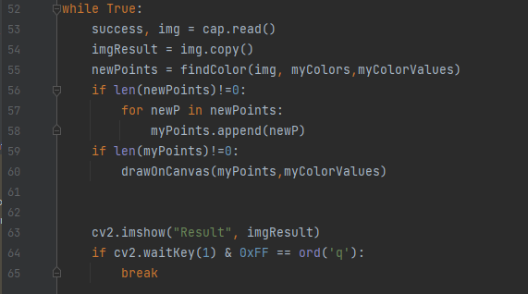
Structure of the code III. Komjáti Gábor – camera drawing
This loop runs continuously until the 'q' key is pressed.
It scans the camera image and then makes a copy.
It finds the preset colors (findColor) and saves the new points.
Adds the new points to the list if it finds any.
Draws all the points found so far (drawOnCanvas).
Displays the result, then checks if the 'q' key was pressed to exit.

Slide 13
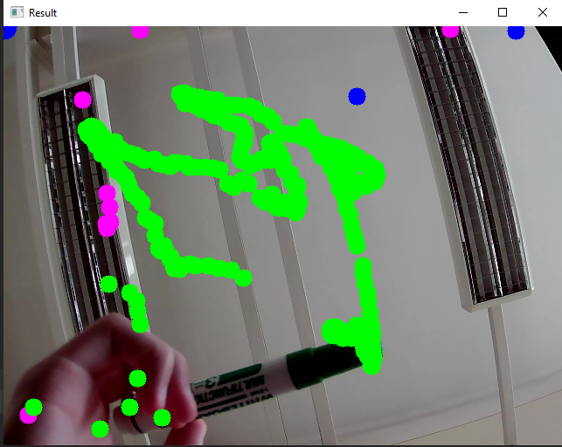
Presentation of the programm Komjáti Gábor – camera drawing

Slide 14
Lengyel Dániel – Number plate recognition

Slide 15
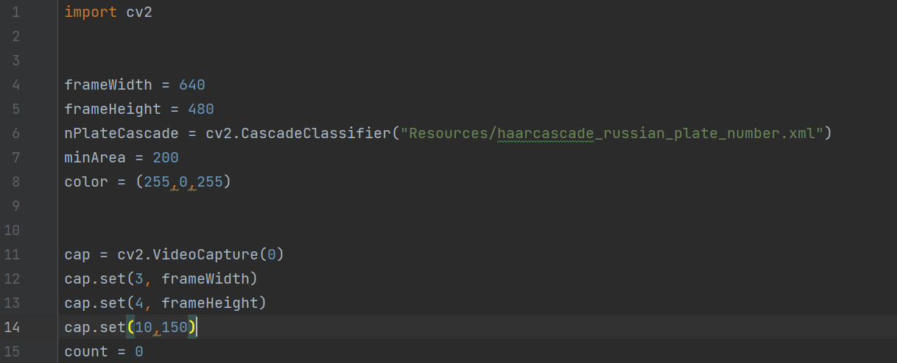
Structure of the code I. Lengyel Dániel – Number plate recognition
Import
Preparing the camera
Loading .xml

Slide 16
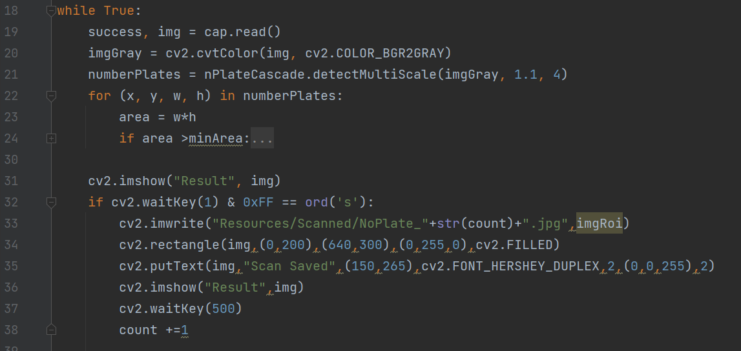
Structure of the code I.
Lengyel Dániel – Number plate recognition
Scan
License plate search
Save to

Slide 17
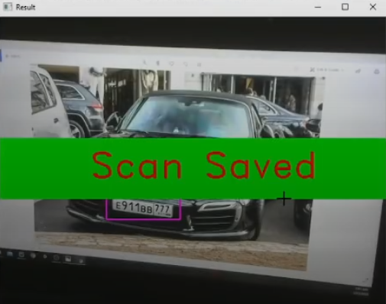
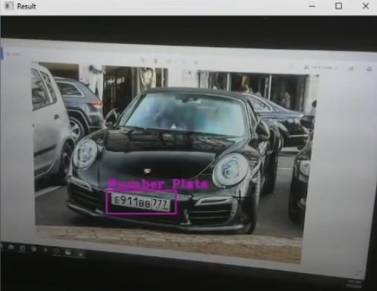
Presentation of the programm Lengyel Dániel – Number plate recognition
The program can:
Recognise from images
Recognize from camera
Save

Slide 18
Thank you for your attention

